Slide 1


Ramseys kitchen
OOP Mini Project
Your desired destination for Bangali and Indian delicacy
Team Members:
Iftekhar Uddin Ahmed-A20EC3016
Md Abu Talha Ibna Riaz Hassan - A20EC3022
Tahia Khan - A20EC3030
Mahamudul Islam - A20EC4083

Slide 2
What this project is about?
This project is about a food ordering system. In this project a customer chooses a type of food and the description of that type of food is displayed.
Then the customer chooses the food he wants to buy and enters in their information (for example, their name, email etc)
Also the customer enters more details about the purchase (for example, they enter the quantity of food to be ordered, they ask for more sauce/cheese, they enter a discount coupon etc)
Then when all the required information is taken, the purchase is confirmed and the receipt is shown to the customer. Using our program, a customer can order one food item at a time.

Slide 3
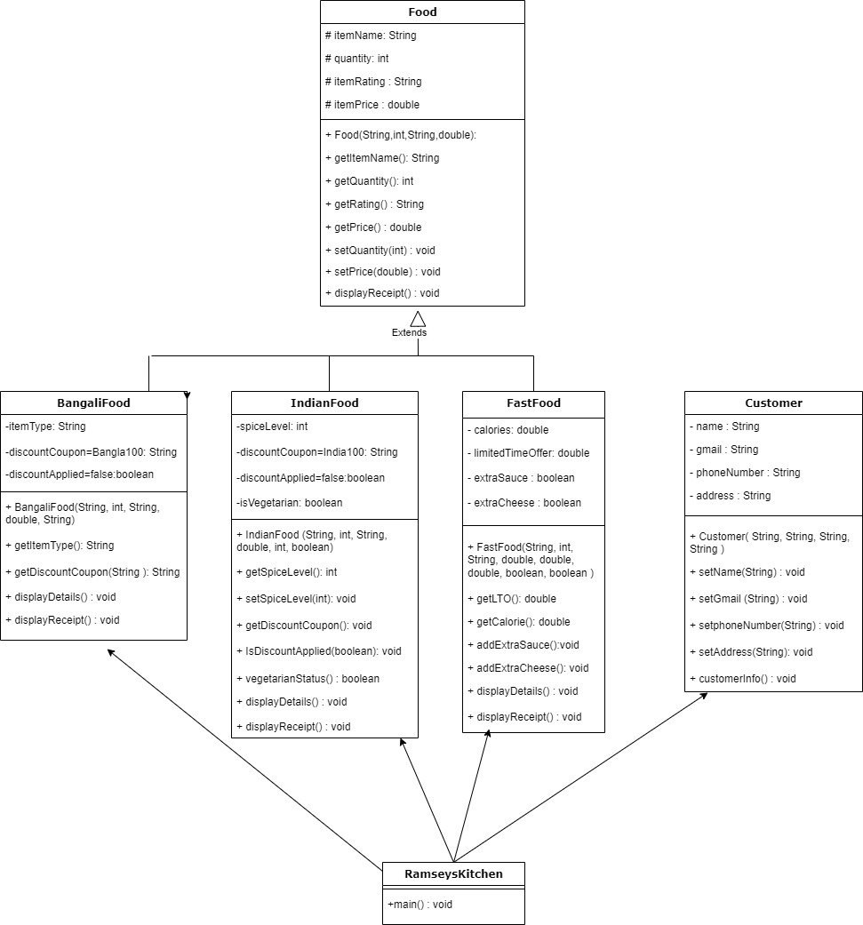
UML DIAGRAM

Slide 4
This project was done using the Java Programming Language and in this project we were asked to apply at least 3 of the following OOP concepts:
a. Array (2D/3D)
b. Encapsulation
c. Data hiding
d. Inheritance
e. Polymorphism
But in our program we applied all of these concepts.

Slide 5
We combined the data and the behaviour of each object into each class, so we implemented encapsulation
We used access modifiers such has private and protected on the attributes of each class so that an object cannot directly access the attributes. Thus we have implemented data hiding.
We have used “Array of objects concept” to store the objects in an array. In our program we have used vector (and it is a dynamic array) thus arrays were used in our project
We have also used inheritance and polymorphism

Slide 6

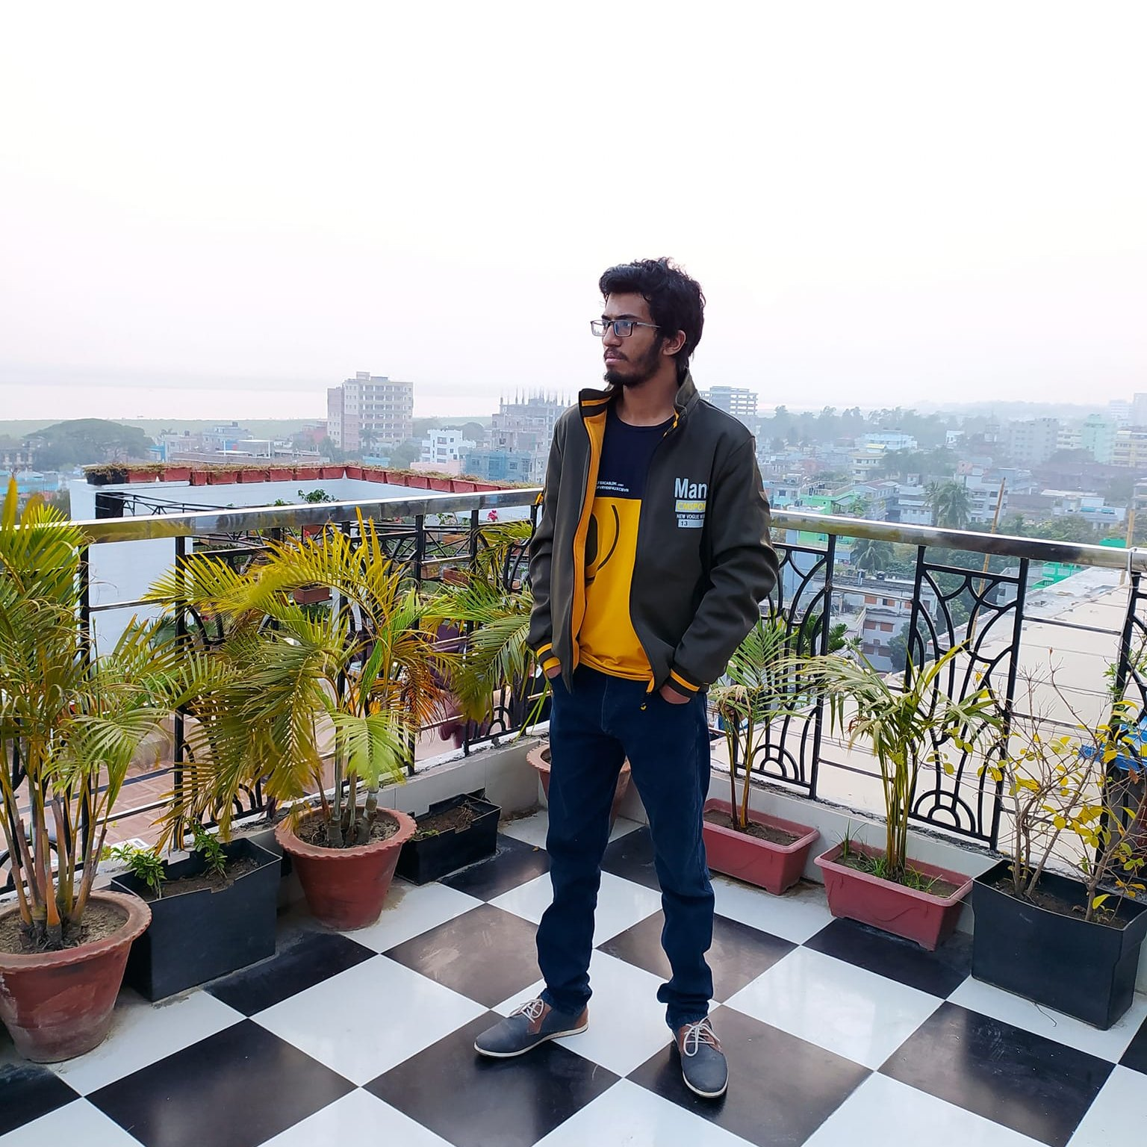
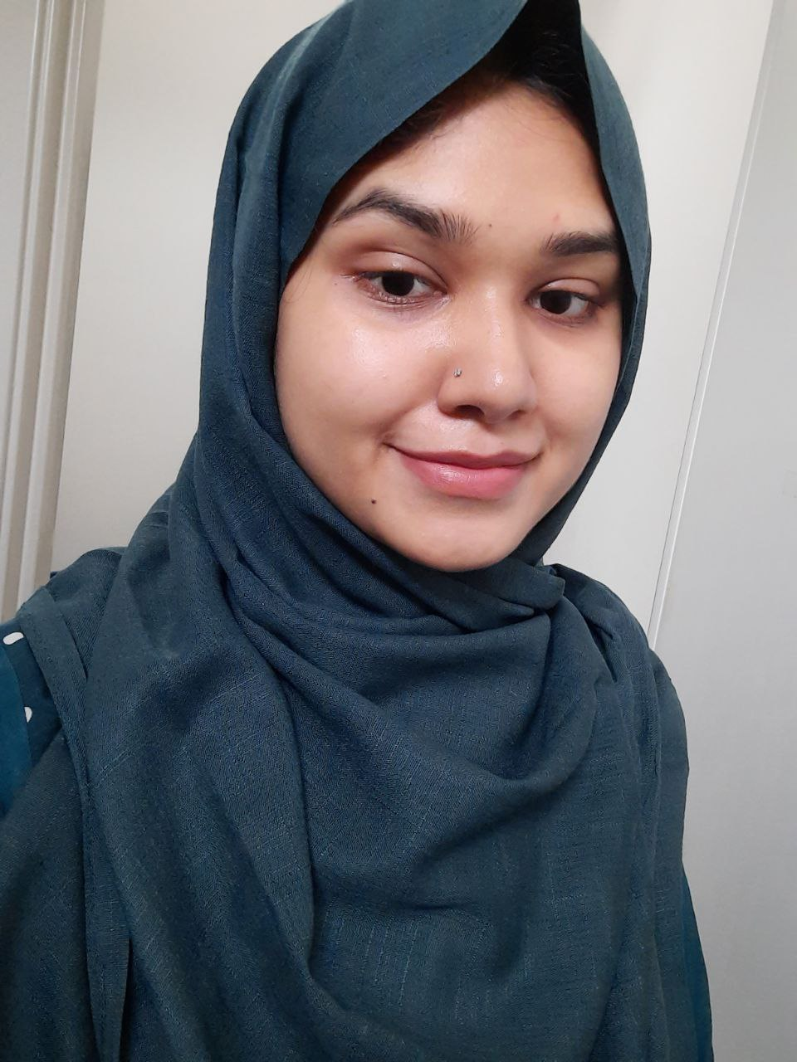
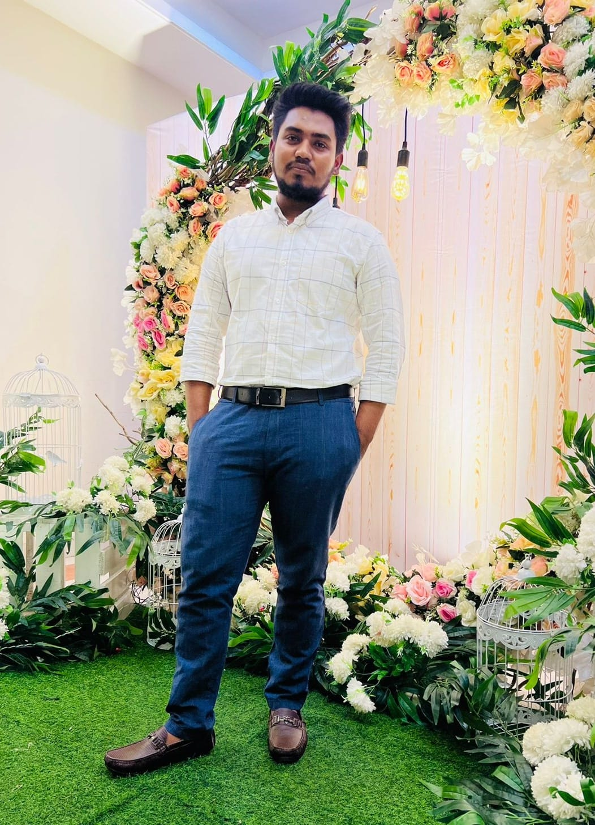
OUR TEAM
Iftekhar Uddin Ahmed
Tahia Khan
Md Abu Talha Ibna Riaz Hassan
Mahamudul islam

Slide 7
THANK YOU
If you have any question, please ask us

